Slide 1
Machine-Independent Optimizations

Slide 2
Code optimization
Elimination of unnecessary instructions
Replacement of one sequence of instructions by a faster sequence of instructions
Local optimization
Global optimizations
based on data flow analyses

Slide 3
Introduction
Organization of an optimizing compiler
Control flow analysis
Data flow analysis
Transformation
Code optimizer

Slide 4
Themes behind Optimization Techniques
Avoid redundancy: something already computed need not be computed again
Smaller code: less work for CPU, cache, and memory!
Less jumps: jumps interfere with code pre-fetch
Code locality: codes executed close together in time is generated close together in memory – increase locality of reference
Extract more information about code: More info – better code generation

Slide 5
Semantics-Preserving Transformations
A number of ways in which a compiler can improve a program without changing the function it computes
Common-sub expression elimination
Copy propagation
Dead-code elimination
Constant folding

Slide 6
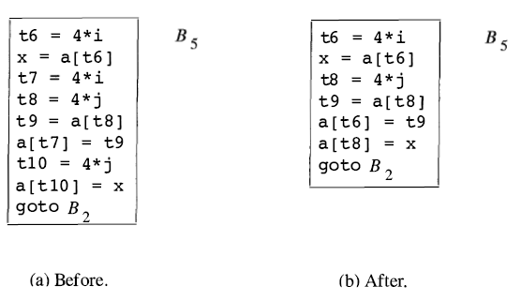
Common Subexpressions
Common subexpression
Previously computed
The values of the variables not changed
Local:

Slide 7
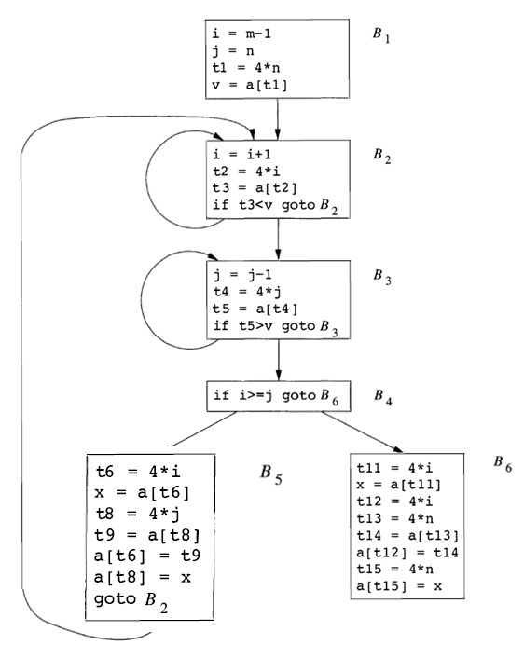
Common Subexpressions
Global
Notes:
Any other common subexpression?

Slide 8
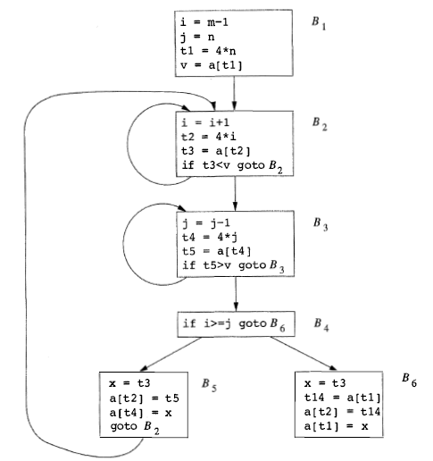
Notes:
Are a[t1] in B1 and in B6 common subexpression?

Slide 9
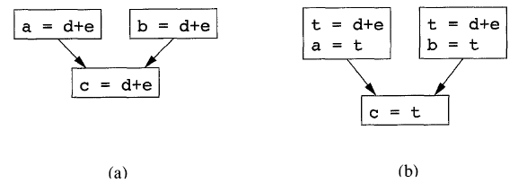
Copy Propagation
Copy statements or Copies
u = v
Notes:
a图中：为了消除d+e，需要引入t变量，并产生a=t,b=t,以及c=t,如图b
但是我们不应该用c=a，或者c=b，因为不一定走a还是b
当有u=v赋值时，后面究竟用v还是u，应该用v，因为可能可以消除u=v

Slide 10
Dead-Code Elimination
Live variable
A variable is live at a point in a program if its value can be used subsequently;
otherwise, it is dead at that point.
Constant folding
Deducing at compile time that the value of an expression is a constant and using the constant instead

Slide 11
Code Motion
Moving code from one part of the program to other without modifying the algorithm
Reduce size of the program
Reduce execution frequency of the code subjected to movement

Slide 12
Dead Code Elimination
int foo(void) {
int a = 24; int b = 25; /* Assignment to dead variable */
int c;
c = a * 4;
return c;
b = 24; /* Unreachable code */
return 0;
}

Slide 13
Code Motion
Code Space reduction: Similar to common sub-expression elimination but with the objective to reduce code size.
Example: Code hoisting
temp : = x ** 2
if (a< b) then if (a< b) then
z := x ** 2 z := temp
else else
y := x ** 2 + 10 y := temp + 10
“x ** 2“ is computed once in both cases, but the code size in the second case reduces.

Slide 14
Code Motion
Execution frequency reduction: reduce execution frequency of partially available expressions (expressions available at least in one path)
Example:
if (a<b) then if (a<b) then
z = x * 2 temp = x * 2
z = temp
else else
y = 10 y = 10
g = x * 2 g = temp

Slide 15
Code Motion
Move expression out of a loop if the evaluation does not change inside the loop.
Example:
while ( i < (max-2) ) …
Equivalent to:
t := max - 2
while ( i < t ) …

Slide 16
Redundant instruction elimination
Redundant load/store: see if an obvious replacement is possible
MOV R0, a MOV a, R0
Can eliminate the second instruction without needing any global knowledge of a
Unreachable code: identify code which will never be executed:
#define DEBUG 0
if( DEBUG) { if (0 != 1) goto L2
print debugging info print debugging info
}
L2:

Slide 17
Algebraic identities
Worth recognizing single instructions with a constant operand:
A * 1 = A
A * 0 = 0
A / 1 = A
A * 2 = A + A
More delicate with floating-point
Strength reduction:
A ^ 2 = A * A

Slide 18
Replace Multiply by Shift
A := A * 4;
Can be replaced by 2-bit left shift (signed/unsigned)
But must worry about overflow if language does
A := A / 4;
If unsigned, can replace with shift right
But shift right arithmetic is a well-known problem
Language may allow it anyway (traditional C)

Slide 19
Usage of Machine idioms
Use machine specific hardware instruction which may be less costly.
i := i + 1
ADD i, #1 INC i

